Slide 1






TRAVEL-EASE
MOBILE APP
BY:
Joshua Amansec
Jerald Bernaldo
Mickel Jhon Lugatiman
Sabtal,Masra J.

Slide 2
TABLE OF CONTENTS
Problem
Solution
Title
PACT Framework
Figma Layout
01
02
03
04
05

Slide 3





PROBLEM
Residents and tourists in Zamboanga City face challenges in accessing transportation and tourist services due to outdated technologies and inefficient systems. This results in disorganized transactions and negatively impacts the quality of service delivery. Both residents and tourists experience difficulties in navigating the city and enjoying their travel experiences.
SOLUTION
Introducing the TravelEase Mobile App, a user-friendly and accessible platform, will significantly improve the transit experience for both residents and tourists. By providing real-time information on transportation options, tourist attractions, and service providers, the app enhances the overall efficiency and convenience of travel in Zamboanga City. Additionally, the app facilitates better communication between residents and tourists, leading to improved service outcomes and a more enjoyable travel experience for all.

Slide 4


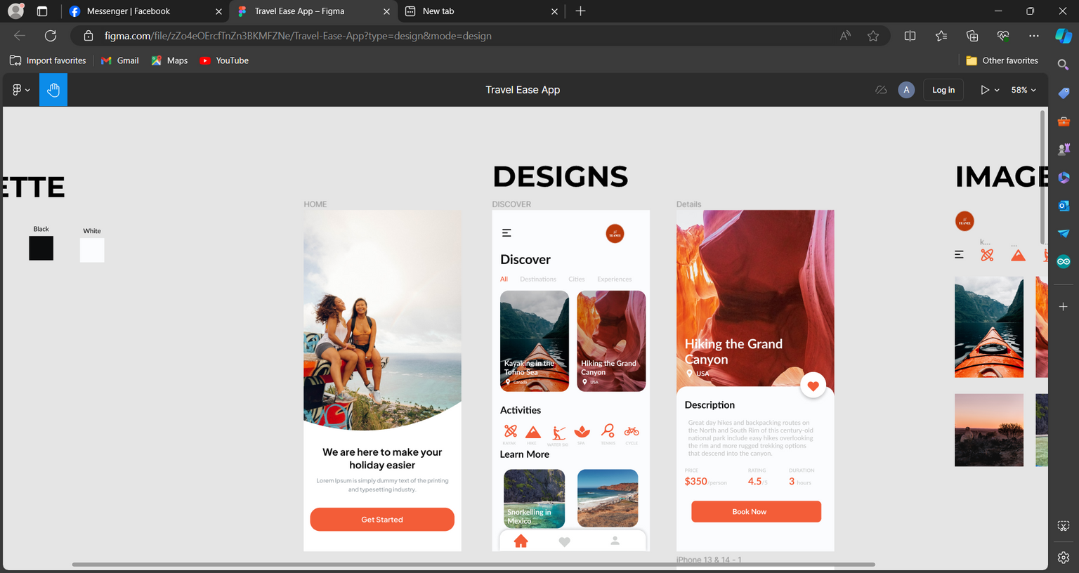
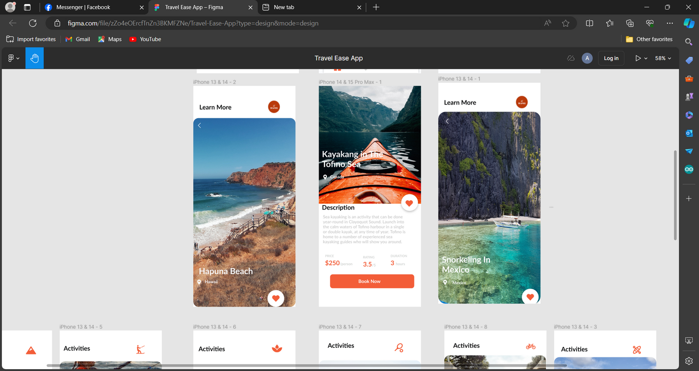


PACT FRAMEWORK
01
02
TRAVEL-EASE FRAME DESIGN
The Designs Travel-Ease APP here have features of Home Page ,Discover Page, Details Page and it will show-up the other view image features suitable for the traveler tourist.

Slide 5



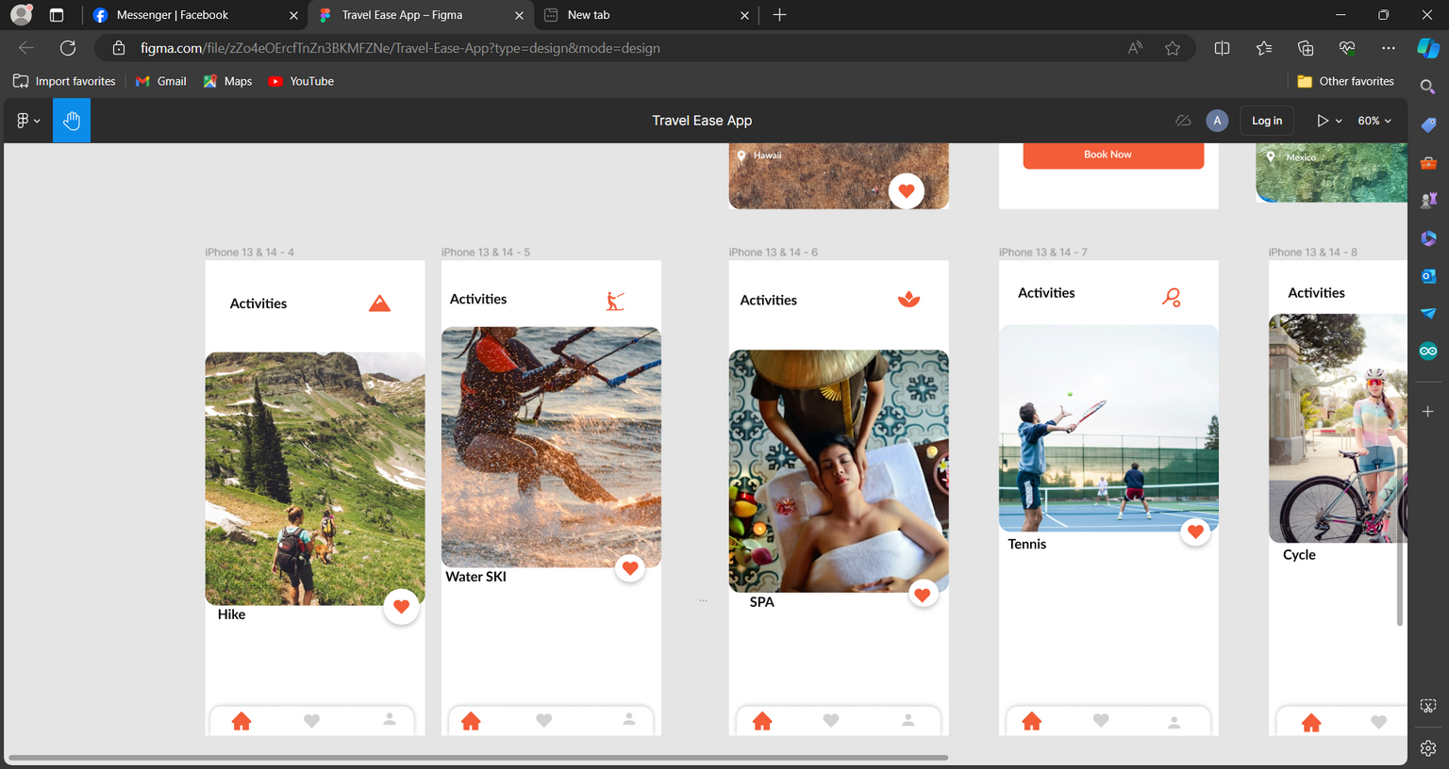
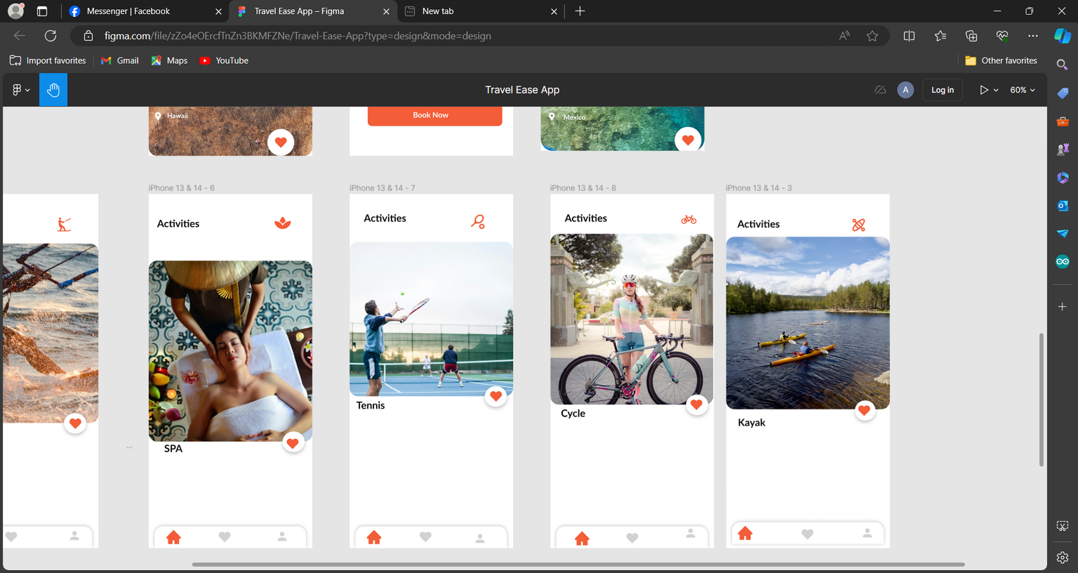


FIGMA LAYOUT
01
04
05
06
02
03
TRAVEL-EASE LAYOUT
MOBILE APP
This feature area of activities, within the Travel-Ease Mobile App have, Tennis Activies,Cycling Activities,Kayak Activies,Hiking Activies,Water SkI Activies and lastly Spa Activies .
Features Included on the Travel-Ease Mobile App

Slide 6



